Slide 1


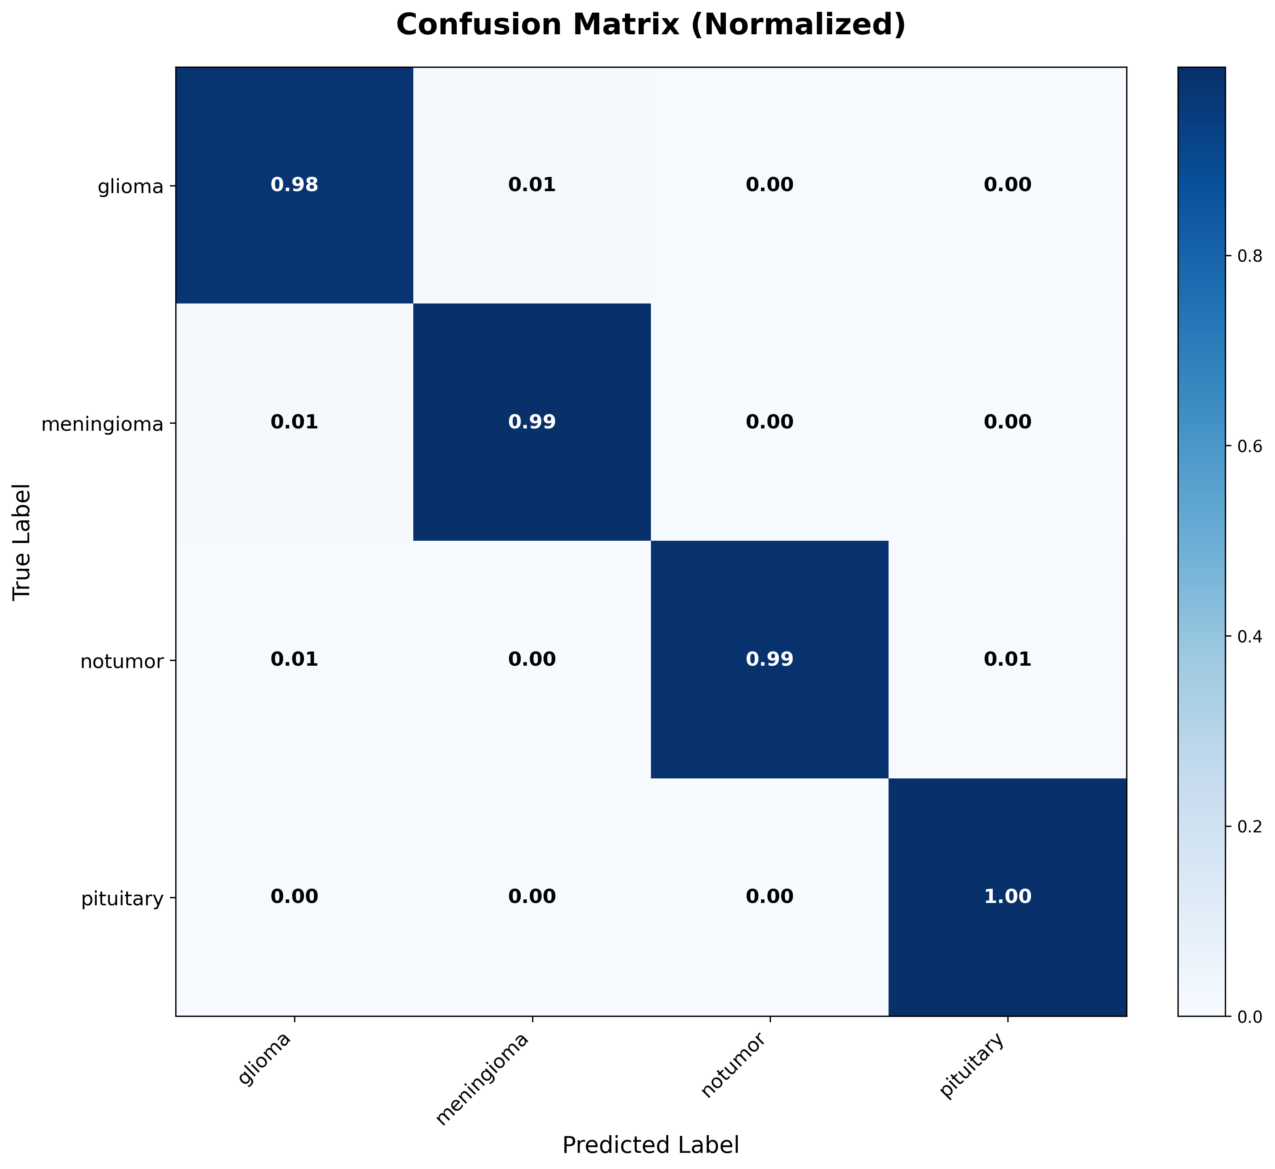
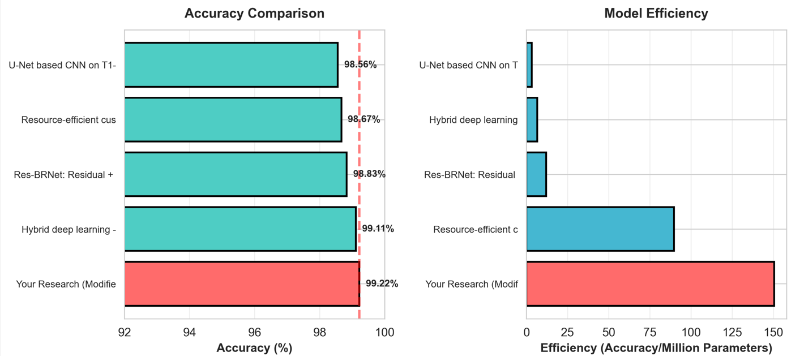
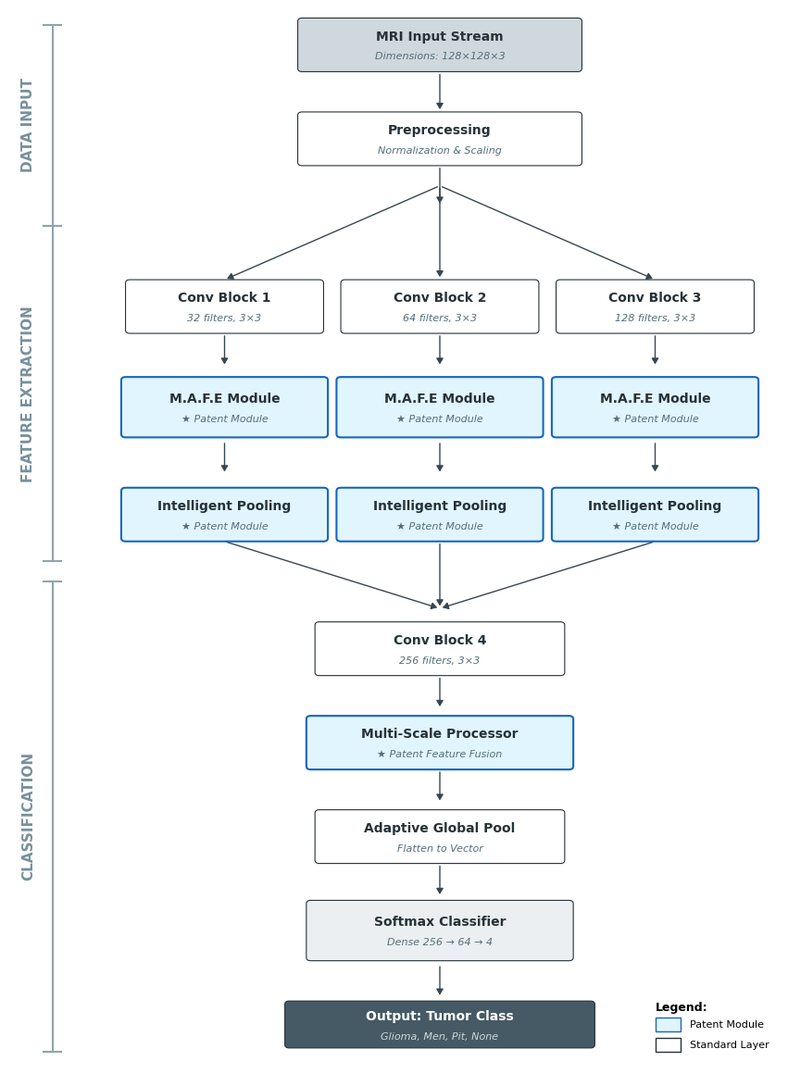
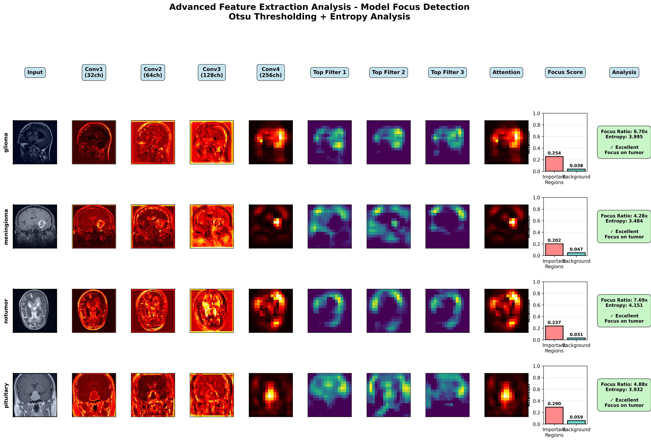
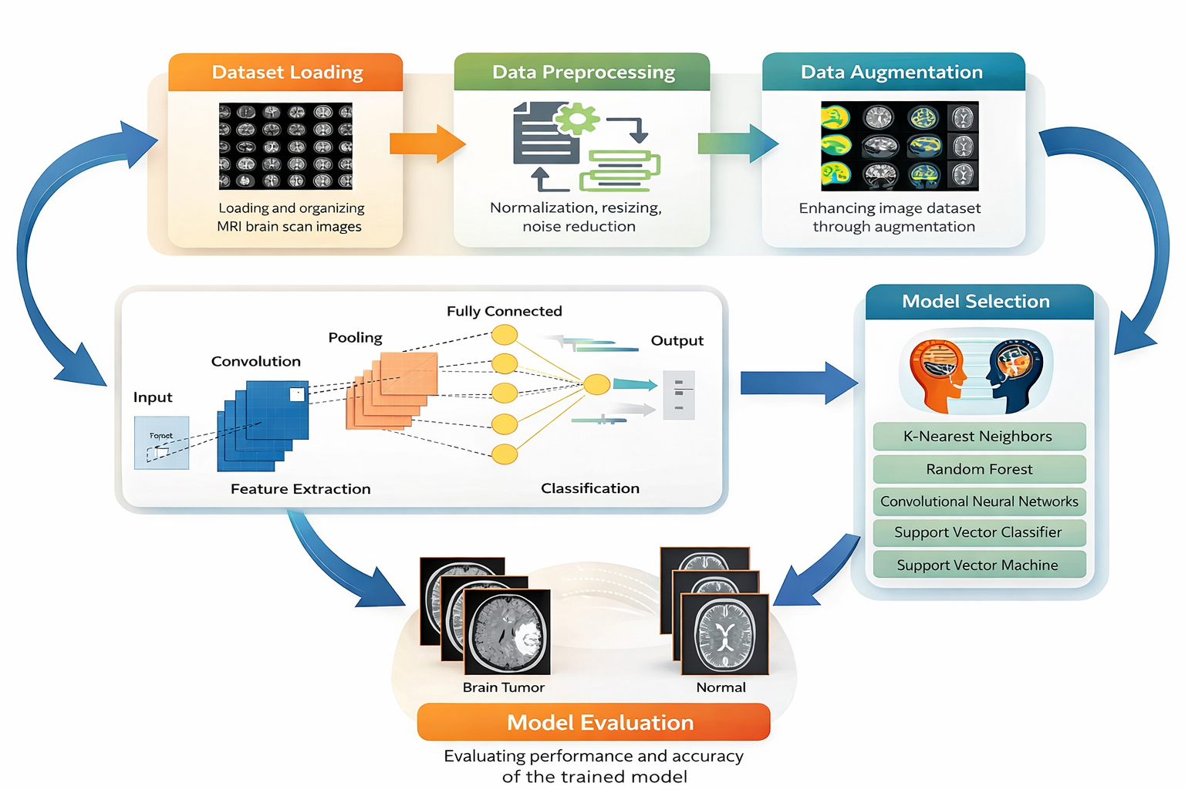
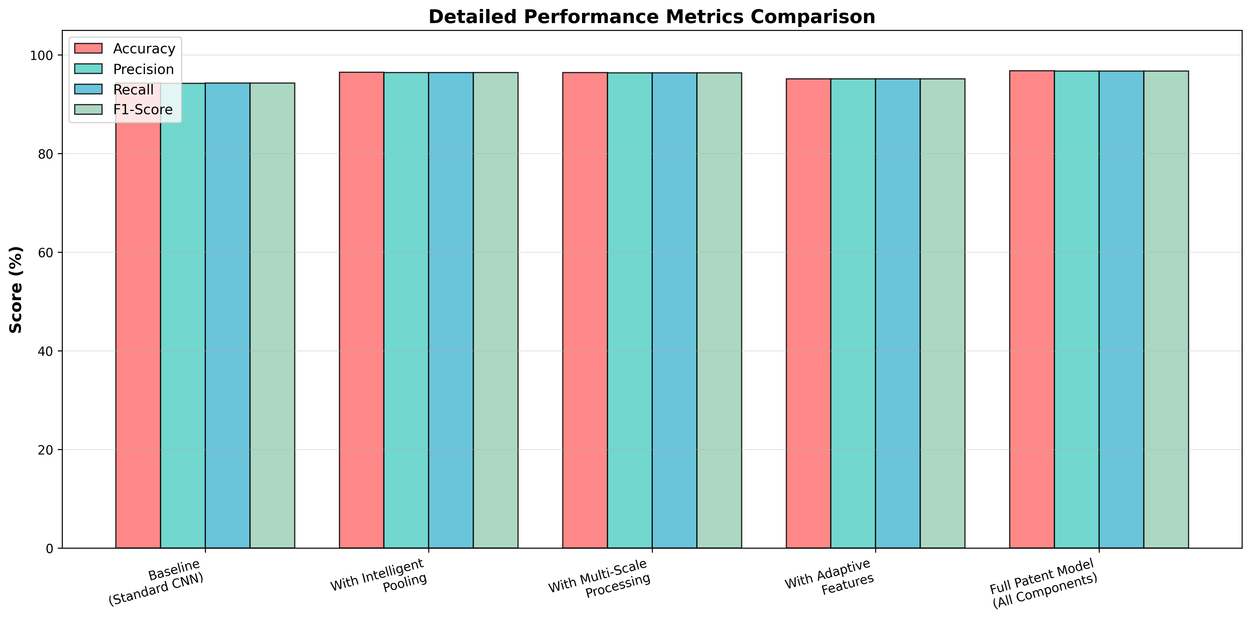
A Novel Deep Learning Approach with Modified CNN for Multi-Class Brain Tumor Classification
Mahmoud Shamran Atheeb, Baraa Ismeal Farhan
Computer Department - College of Education for Pure Science
INTRODUCTION
RESEACH OBEJCTIVE
What is Brain Tumor Classification?
Brain tumor classification involves the automated detection and categorization of brain tumors using Magnetic Resonance Imaging (MRI) scans. In traditional clinical practice, radiologists manually review MRI images, a process that can be time-consuming, subjective, and prone to human error. Automated classification plays a central role in Computer-Aided Diagnosis (CAD) systems by improving efficiency and supporting clinical decision-making. Our research introduces an ultra-lightweight Convolutional Neural Network (CNN) model that integrates three novel patent-pending components. The first is a Micro Adaptive Feature Extractor that dynamically adjusts feature importance through spatial attention mechanisms.
Develop an ultra-light CNN for accurate brain tumor classification from MRI scans, integrating three novel patented components with minimal computational cost.
outperforming recent studies by up to 0.66% with superior efficiency.
METHODOLOGY
MATHEMATICAL MODEL
Adaptive feature extraction for MRI tumor detection using attention mechanisms:
Spatial Attention: (1)
where σ denotes sigmoid activation function and Conv represents convolution operations.
Channel Attention: (2)
where GAP denotes Global Average Pooling and Wc​ is the channel attention weight.
Adaptive Output: (3)
CONCLUSION
This research demonstrates an ultra-lightweight CNN architecture achieving 96.8% accuracy for brain tumor classification with only 487K parameters and 12ms inference time, making it ideal for deployment on resource-constrained medical devices while maintaining diagnostic-grade performance.
PROBLEM STATEMENT
REFERENCES
Khan S, Ahmed N, Malik K, et al. High-precision brain tumor classification from MRI images using an advanced hybrid deep learning method with minimal radiation exposure. 2025;98:103252.
Khan MA, Auvee RB. Comparative analysis of resource-efficient CNN architectures for brain tumor classification. arXiv preprint arXiv:2411.15596. 2024.
Zahoor A, Khan S, Malik K, et al. Res-BRNet: Residual and region-boundary aware CNN for brain tumor classification from MRI. Biomedicines. 2024;12(7):1395.
Litjens G, Kooi T, Bejnordi BE, et al. A survey on deep learning in medical image analysis. Medical Image Analysis. 2017;42:60–88.
THE RESULTS
The model achieved 99.22% accuracy, with pituitary tumors scoring the highest F1-score of 99%.
A total of 15 samples were misclassified: 11 glioma, 4 meningioma, and 1 pituitary cases.

